Slide 1

Introduction to Computer System
Presented By:
Elizer Ponio Jr.

Slide 2
Introduction to Computer System
What is a computer system?
Features of a computer system
Computer hardware and software
Components of a computer system
Benefits of using a computer system

Slide 3
What is a Computer System?
A computer system is defined as a digital electronics device that can be programmed to accept some input in terms of data, then process this data depending on the program instruction and provide the output in the desired format.

Slide 4
Features of a Computer System
A computer system is programmable
A computer system accepts raw data and produces information
A computer system is a digital machine
A computer system consists of hardware and software.
Notes:
Computer programs consist of a set of instruction that directs the computer system hardware components to perform the desired operations
The computer is a digital electronic machine. Which means a computer can understand and execture instructions on in binary which consists of only two numbers 0 and 1

Slide 5
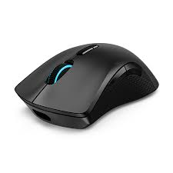
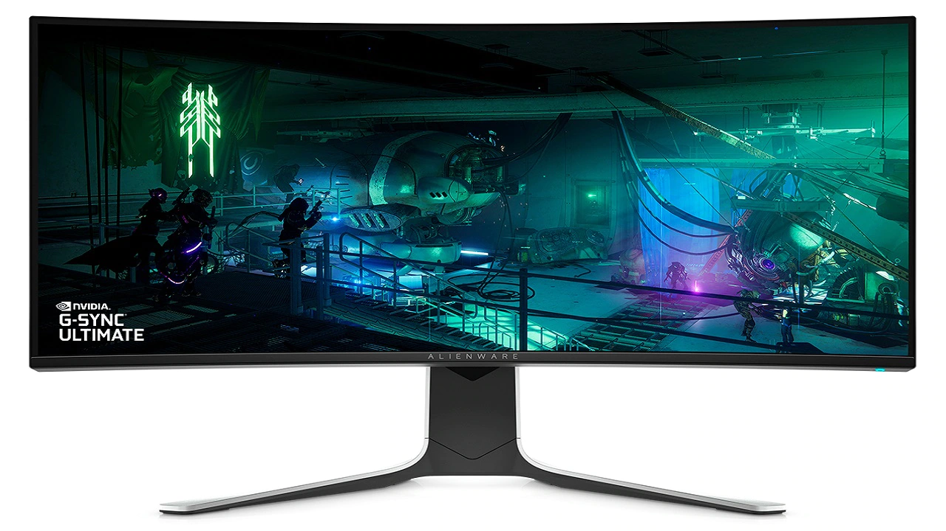
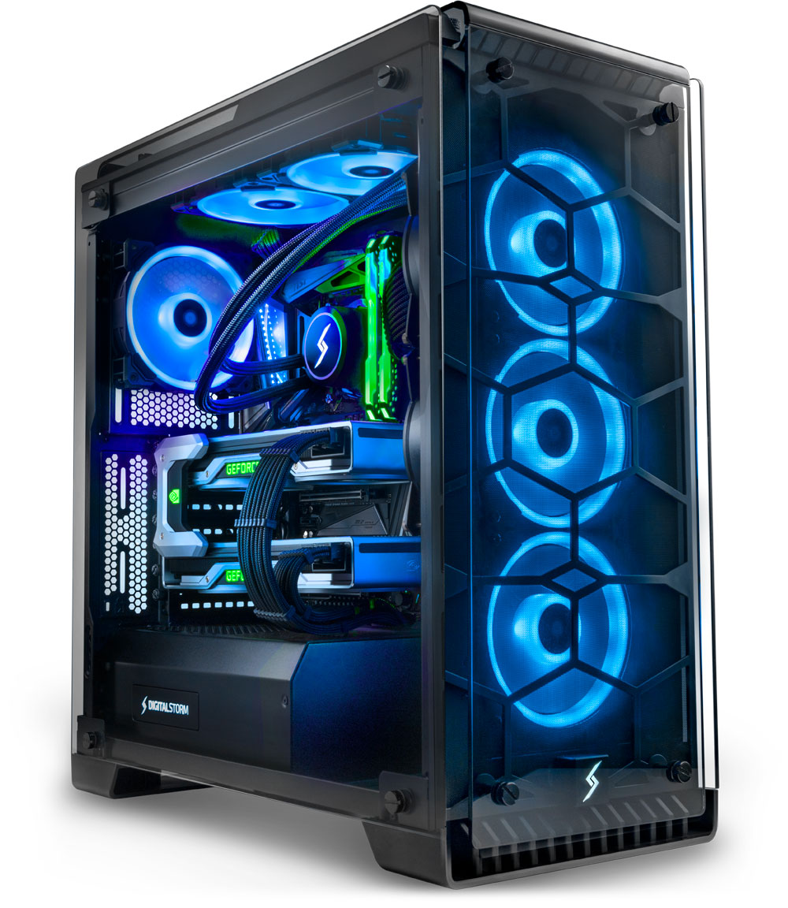
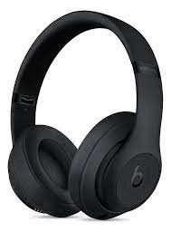
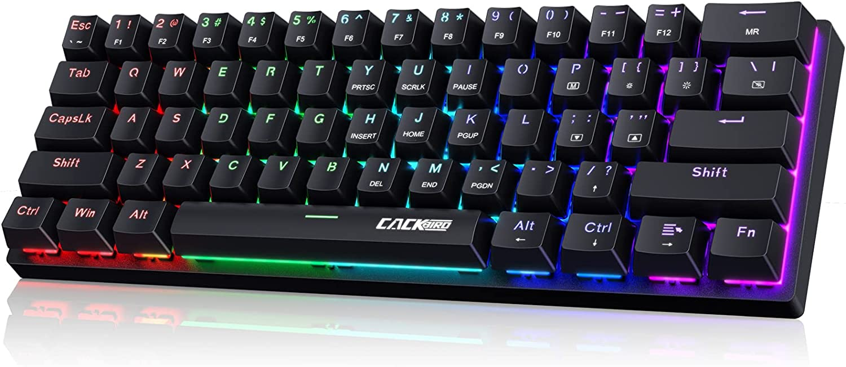
Computer Hardware
Notes:
Hardware components are physical parts that we can touch and interact

Slide 6
Computer Software
System Software
Application Software
Notes:
Software/Program is a component which directs the computer to perform various tasks

Slide 7
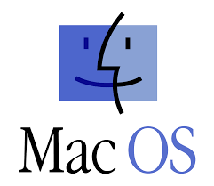

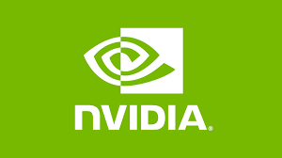
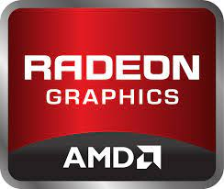
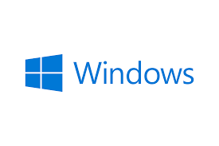
System Software
Operating System
Device Drivers
Notes:
System Software is a type of software that is internally used by the computer itself to manage and operate the various hardware components connected to the system
The operating system is used by the computer to provide an interface to the user to interact with the system.

Slide 8






Application Software
Notes:
Application software is directly used by the system user to perform different tasks

Slide 9
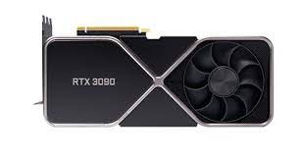


Hardware and Software
System User
Hardware
Application Software
Operating System
Device Driver

Slide 10
Components of a Computer System
Input Unit
Central Processing Unit
Memory Unit
Output Unit
Notes:
In terms of functionality, a computer system can be grouped in to four units

Slide 11
Components of a Computer System
Input Unit
Memory Unit
Output Unit
Central Processing Unit
Notes:
Computer System Block Diagram

Slide 12
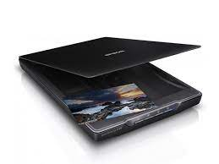
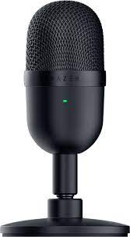
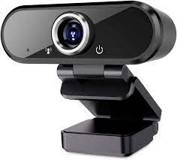
Input Unit
Notes:
Input devices accept data

Slide 13
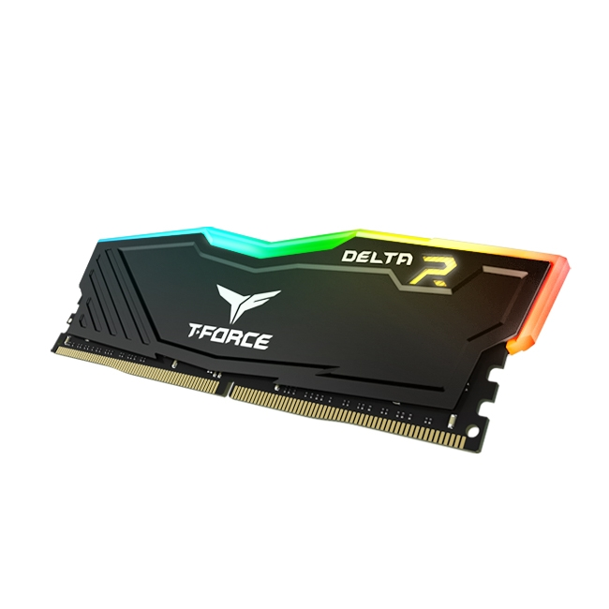
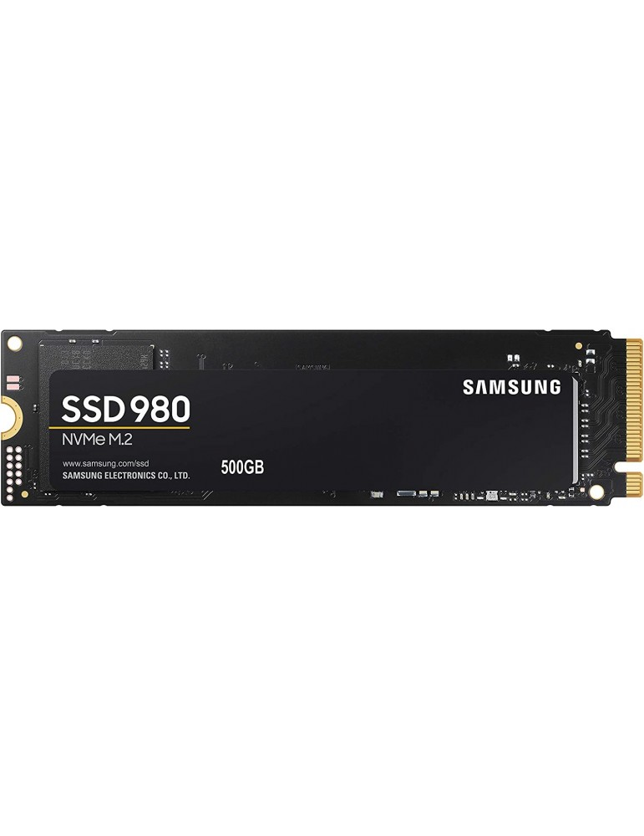

Memory Unit
Notes:
Memory units store data and program instructions during program execution
RAM
HDD
SSD
Cache memory
CPU registers

Slide 14
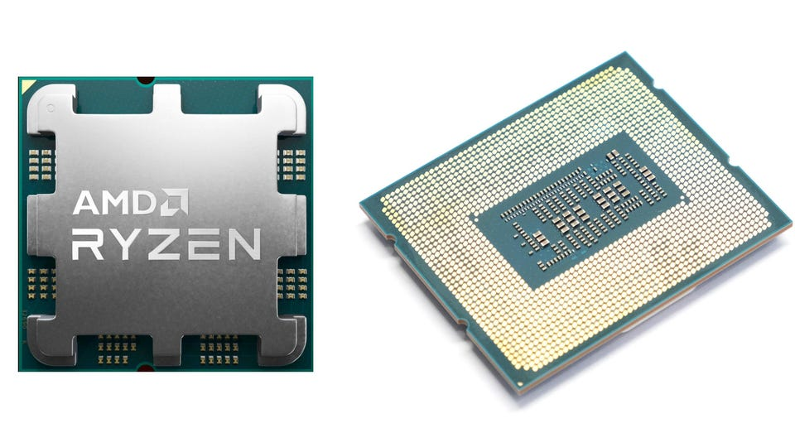
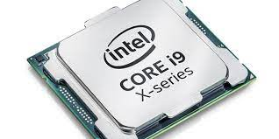
Central Processing Unit
Notes:
The brain of the computer system. The main function of the CPU is to execute computer programs.

Slide 15
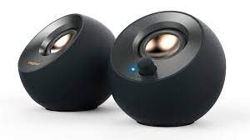
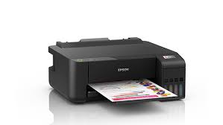
Output Unit
Notes:
Input devices accept data

Slide 16
Benefits of using a Computer System
Processing Speed
Accuracy of Operations
Data Storage
Fast logical Decisions
Repetitive tasks
Notes:
In terms of functionality, a computer system can be grouped in to four units

Slide 17

Processing Speed
Notes:
In terms of functionality, a computer system can be grouped in to four units

Slide 18

Data Storage
Notes:
In terms of functionality, a computer system can be grouped in to four units

Slide 19

Accuracy of Operations
Notes:
In terms of functionality, a computer system can be grouped in to four units

Slide 20

Decision Making
Notes:
In terms of functionality, a computer system can be grouped in to four units

Slide 21

Repetition
Notes:
In terms of functionality, a computer system can be grouped in to four units

